Slide 1
Project Update
Sean Hung
Yu-Kai Wang
Jonathon Li
Matt Uryga

Slide 2
Overview

Slide 3
End Goals
Data scraping from Twitter/Reddit
Utilization of different similarity metrics to determine if two cryptocurrencies are likely to have similar price movement
Implementation of emotion-oriented clustering to include general sentiment in predicted outcome
Prediction of crypto price movement

Slide 4
Current Progress and Findings

Slide 5
Current Progress and Findings
Reddit Scraping and
Sentiment Analysis
Price History and Current Price
We are getting price history from Binance
This data also includes volume and OHLC prices
We are using 4hr bars
We are Yahoo Finance to fetch realtime data
TALib is being used for easy access to various indicators
Price history and other data is being stored as a graph
Unique crypto currencies are the nodes
Edges contain several different weights, one for each similarity metric
For every Reddit post on r/Cryptocurrency with a specific query, the following data is collected:
Post date and time
Title
Author
Flair
Post ID
Sentiment analysis is being done with BERT
Model used is Hugging Face-bert-base-uncased
Accuracy is >90%
Posts are being classified as bullish, bearish, or neutral

Slide 6
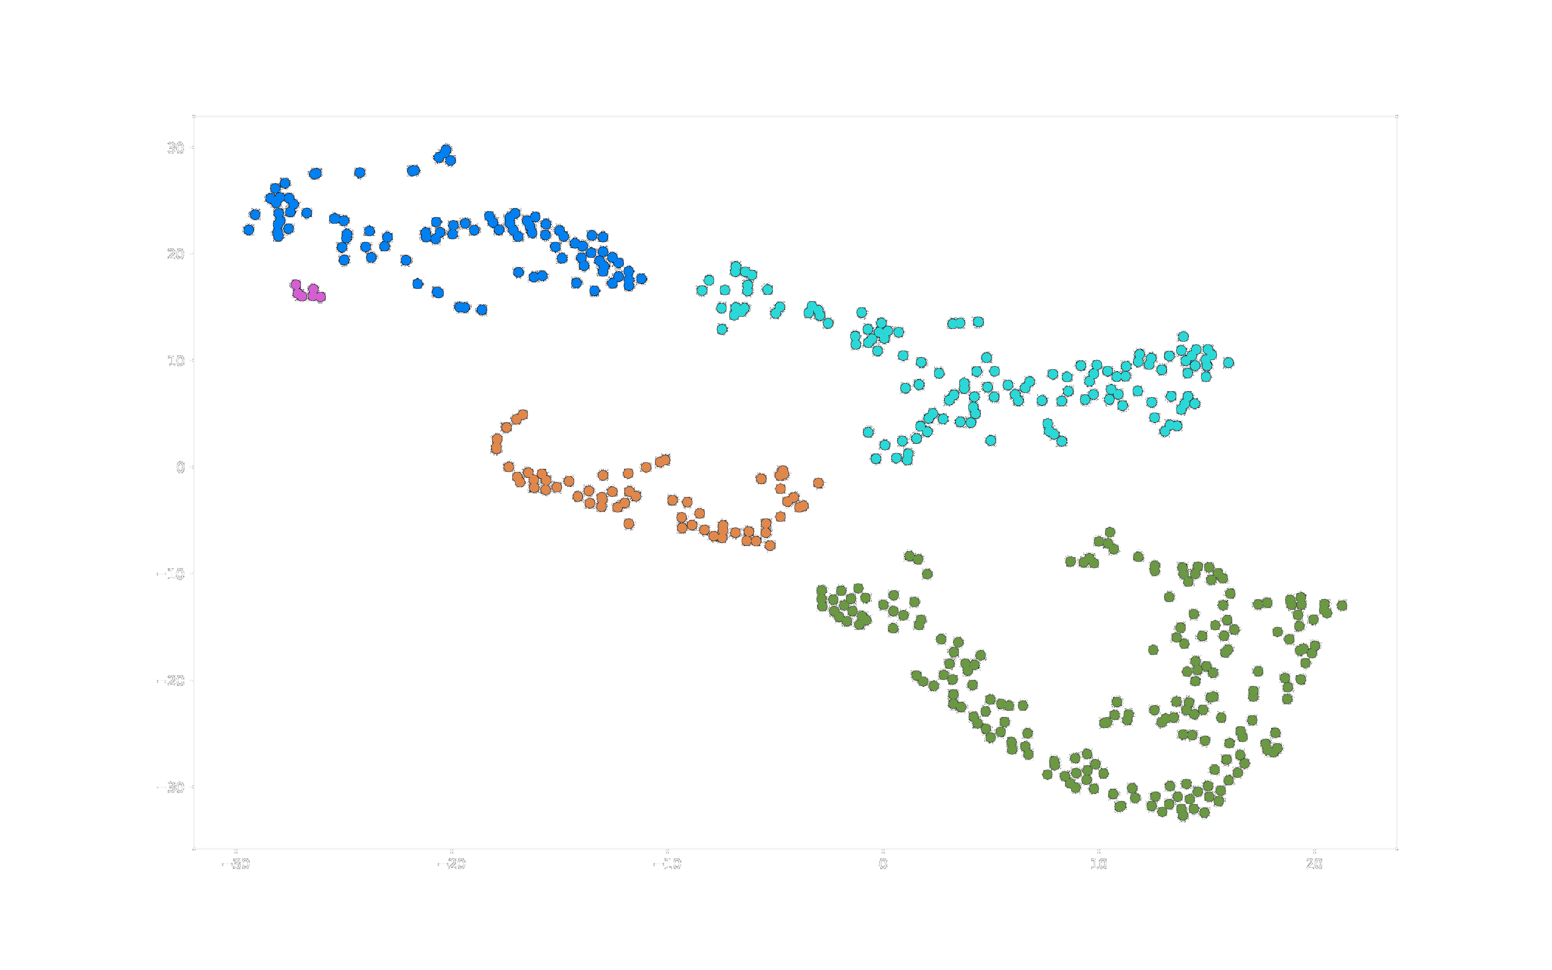
DBSCAN Clustering
Due to the volatility of the crypto market, there will inevitably be outliers in the data
Clustering methods such as k mean clustering sensitive to outliers
DBSCAN fixes this issue by clustering points based on density
Outliers have low density, thus they are treated as noise and disregarded

Slide 7
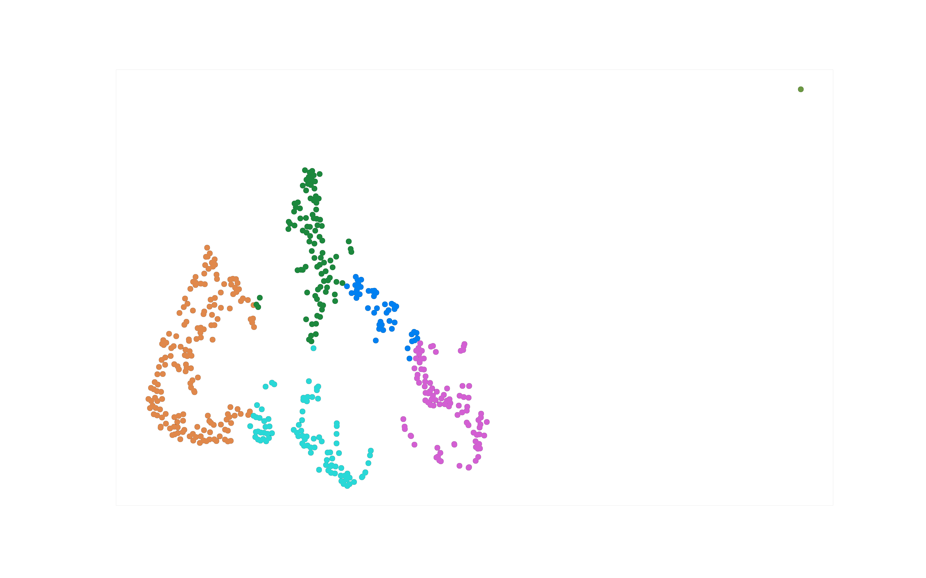
T-SNE
T-distributed Stochastic Neighbor Embedding
For each crypto assets, we have a list of metadata associated with it
Max supply, market cap, circulating supply, etc.
To aggregate these values, we trained a T-SNE model to compress these features into 2-dimensional space
We then use K-means clustering to categorize the crypto assets with the T-SNE embedding
This artificial feature can represents the metadata of each crypto to a certain degree

Slide 8
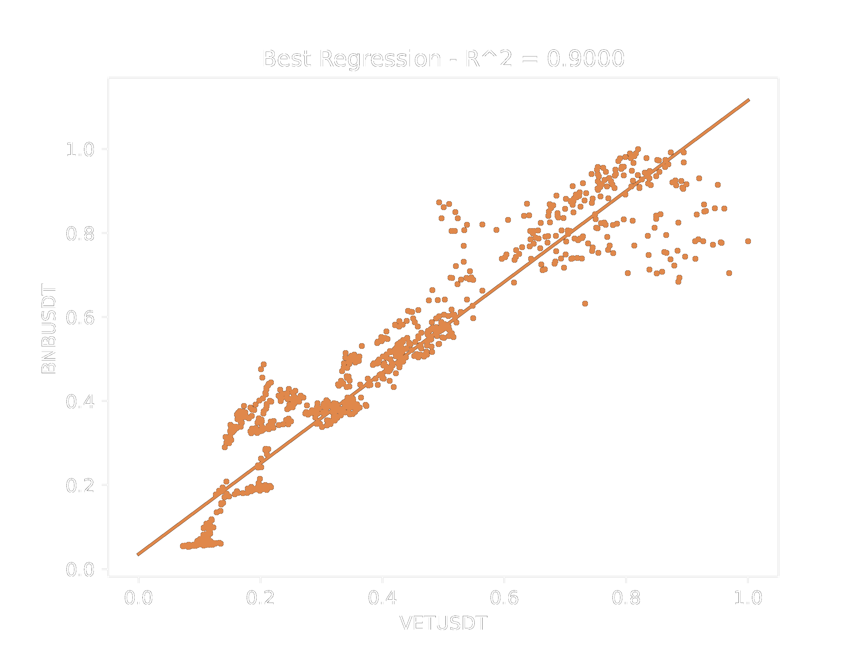
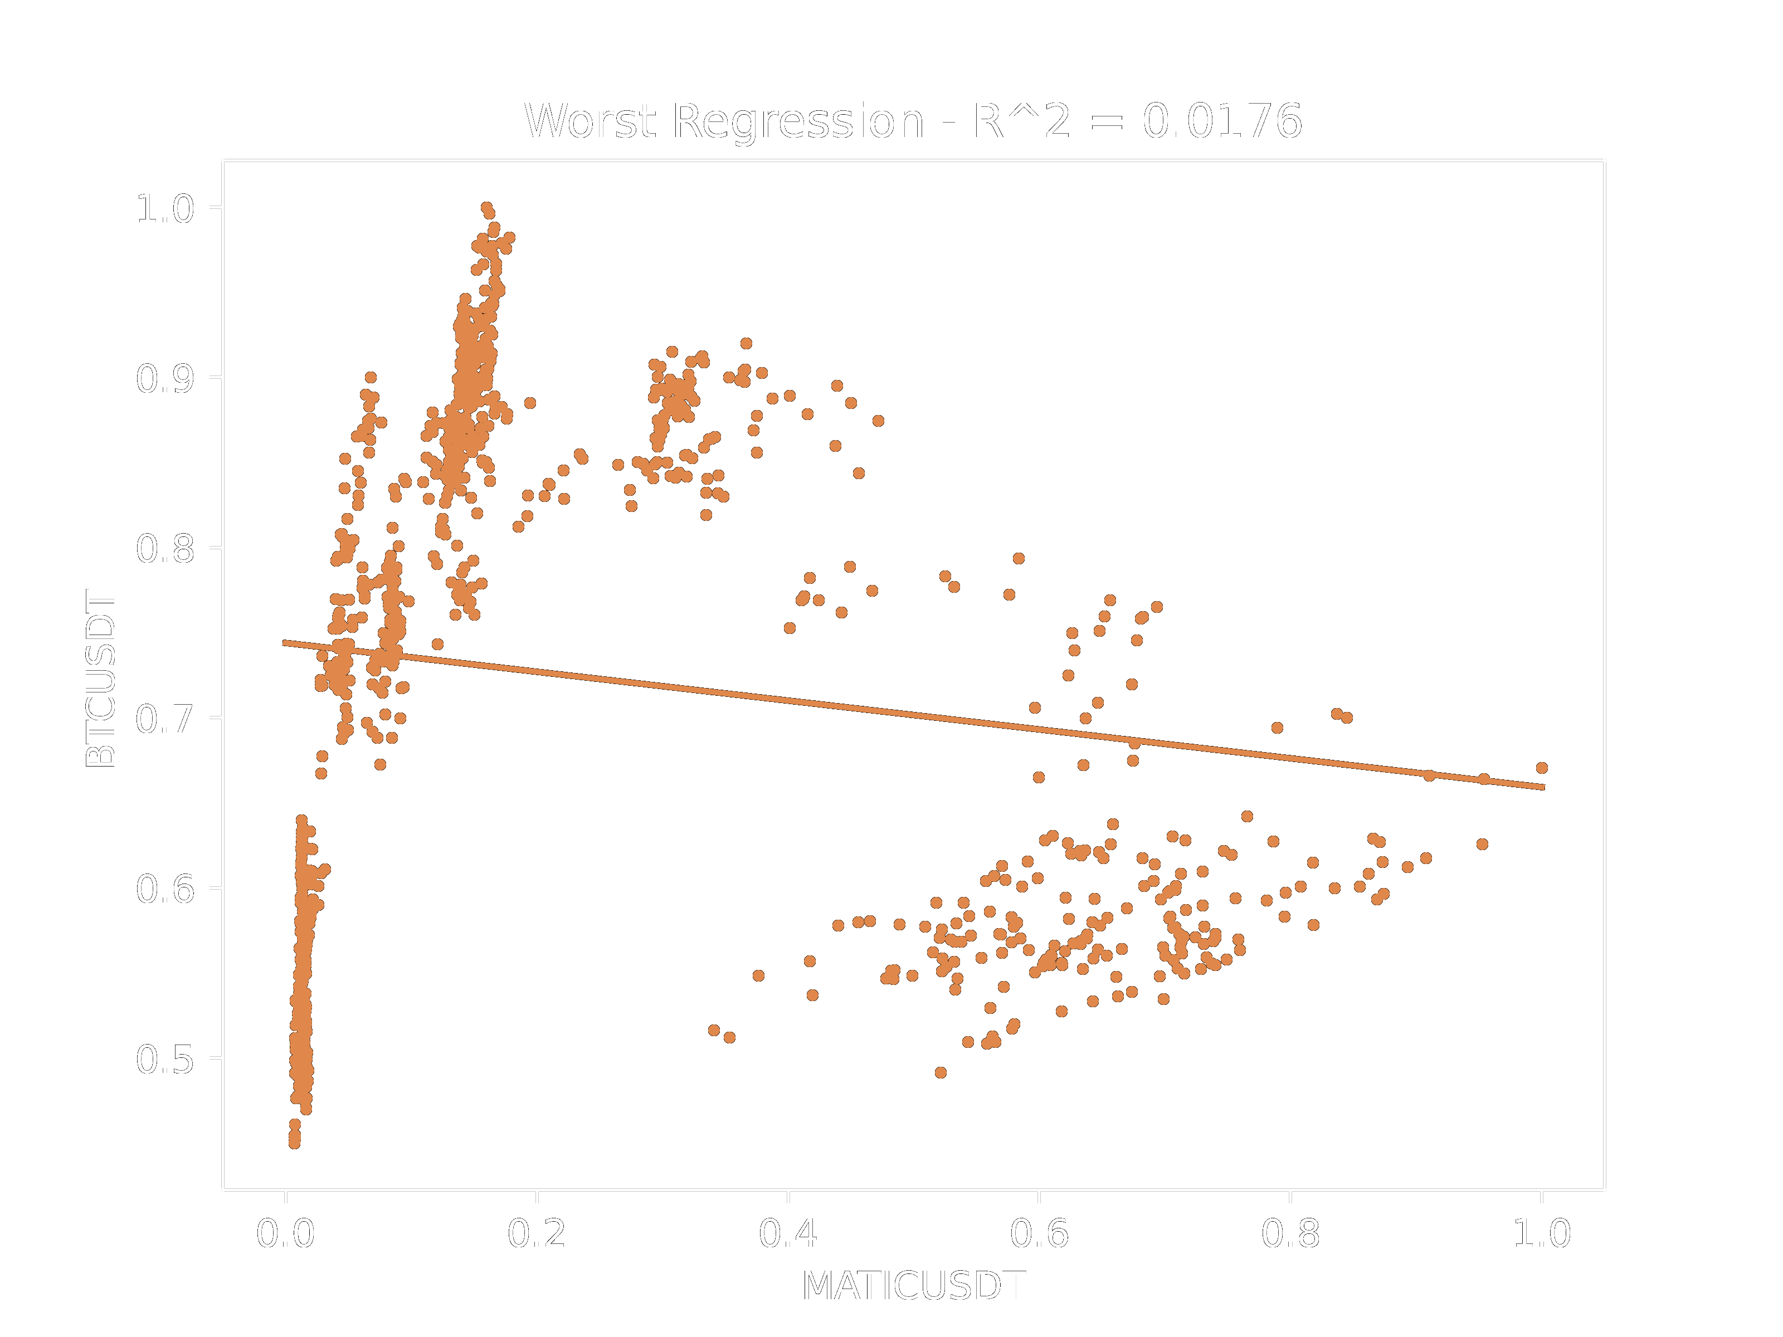
Regression Similarity

Slide 9
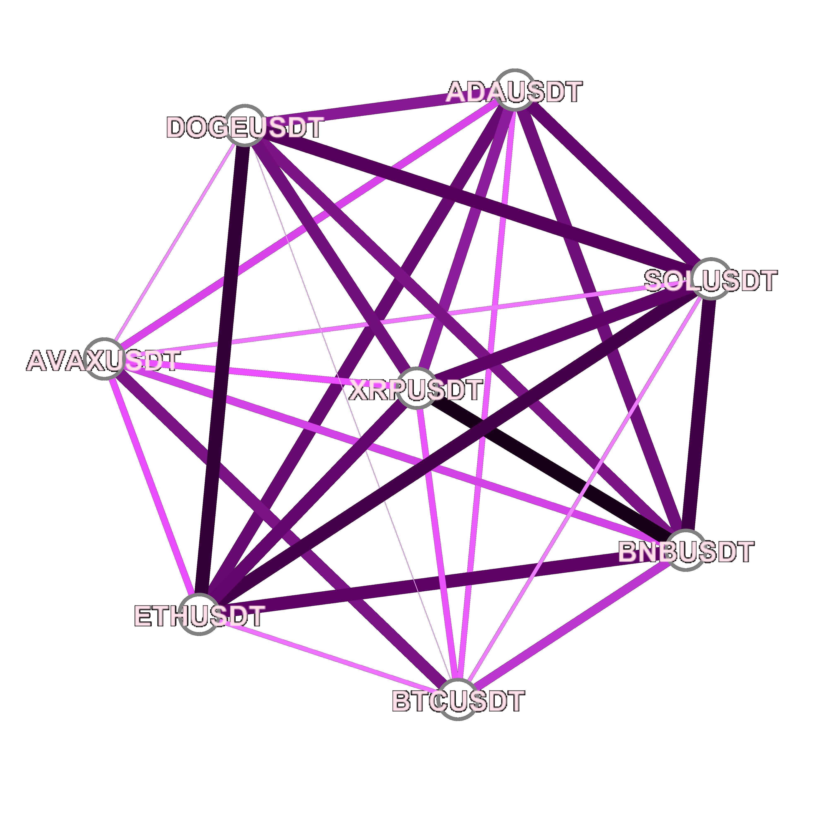
Regression Similarity (cont’d)
This is a visualization of 8 different cryptocurrencies
A linear regression has been computed for every edge, and the edge’s weight is the r^2 value for the regression
Darker edges have a stronger correlation than lighter edges

Slide 10
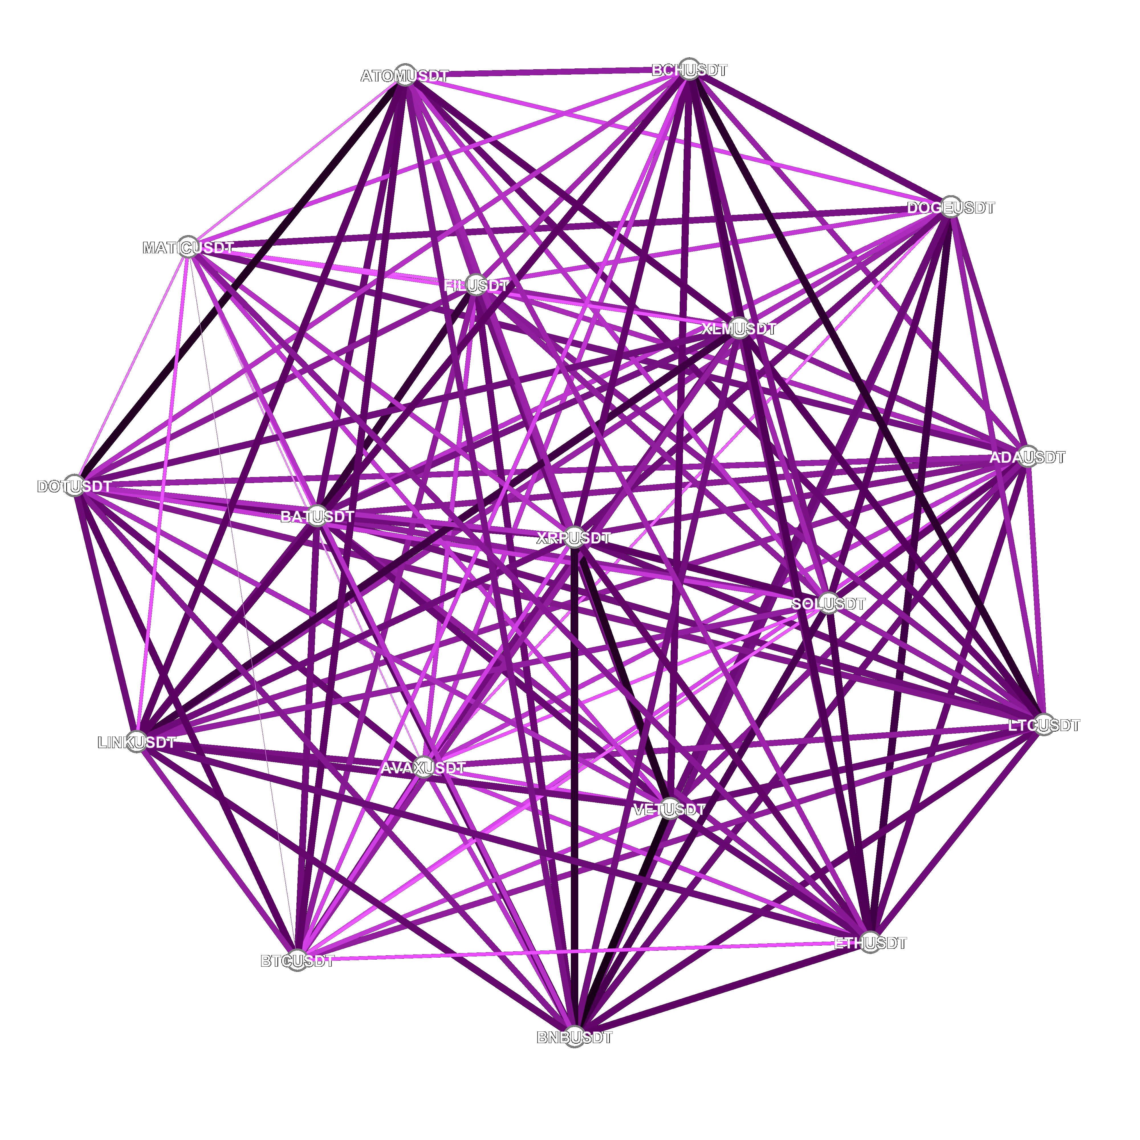
Regression Similarity (cont’d)
This is the same visualization but with 18 cryptocurrencies

Slide 11
Challenges and Problems

Slide 12
Challenges and Problems
Twitter Scraping
Historical Price Data
Twitter API does not let you access tweets from more than 7 days ago
We decided to use Twitter for realtime sentiment scraping only
Historical price data fetched through the Binance API is lacking for some coins
Recorded prices only go back so far
BERT Implementation
Procrastination
BERT is hard
Turns out that we are very good at putting things off until later on

Slide 13

Challenges and Problems (cont’d)
Jon

Slide 14
Looking Ahead

Slide 15
Looking Ahead
Accounting for Realtime
Price and News
Aggregate Similarity Algorithm
We are currently only using historical price data to determine similarity and buy/sell signals
Most of the framework is already in place, we just have to implement realtime processing
As stated before, we will be using Twitter for getting realtime news, and the Binance API for prices
Ultimately, we want to attempt to combine these various similarity metrics into some kind of weighted algorithm that performs better than any of its individual components

